Slide 1

Chapter 6
Bandwidth Utilization:
Multiplexing and Spreading
6.<number>
Copyright © The McGraw-Hill Companies, Inc. Permission required for reproduction or display.

Slide 2

Note
Bandwidth utilization is the wise use of
available bandwidth to achieve
specific goals.
Efficiency can be achieved by multiplexing; privacy and anti-jamming can be achieved by spreading.
6.<number>

Slide 3
6-1 MULTIPLEXING
Whenever the bandwidth of a medium linking two devices is greater than the bandwidth needs of the devices, the link can be shared. Multiplexing is the set of techniques that allows the simultaneous transmission of multiple signals across a single data link. As data and telecommunications use increases, so does traffic.
Topics discussed in this section:
Frequency-Division Multiplexing
Wavelength-Division Multiplexing
Synchronous Time-Division Multiplexing
Statistical Time-Division Multiplexing
6.<number>

Slide 4

Figure 6.1 Dividing a link into channels
6.<number>

Slide 5

Figure 6.2 Categories of multiplexing
6.<number>

Slide 6
Note
FDM is an analog multiplexing technique that combines analog signals.
6.<number>

Slide 7

Figure 6.3 Frequency-division multiplexing
6.<number>

Slide 8
Frequency Division Multiplexing(FDM)
An analog technique that can be applied when the bandwidth of a link (in hertz) is greater than the combined bandwidths of the signals to be transmitted.
Signals generated by each sending device modulate different carrier frequencies.
These modulated signals are then combined into a single composite signal

Slide 9

Figure 6.4 FDM process
6.<number>

Slide 10
Frequency Division Multiplexing(FDM)
Carrier frequencies are separated by sufficient bandwidth to accommodate the modulated
These bandwidth ranges are the channels through which the various signals travel.
Channels can be separated by strips of unused bandwidth—guard bands—to prevent signals from overlapping.
6.<number>

Slide 11

Figure 6.5 FDM demultiplexing example
6.<number>

Slide 12
Example 6.1
Assume that a voice channel occupies a bandwidth of 4 kHz. We need to combine three voice channels into a link with a bandwidth of 12 kHz, from 20 to 32 kHz. Show the configuration, using the frequency domain. Assume there are no guard bands.
Solution
We shift (modulate) each of the three voice channels to a different bandwidth, as shown in Figure 6.6. We use the 20- to 24-kHz bandwidth for the first channel, the 24- to 28-kHz bandwidth for the second channel, and the 28- to 32-kHz bandwidth for the third one. Then we combine them as shown in Figure 6.6.
6.<number>

Slide 13

Figure 6.6 Example 6.1
6.<number>

Slide 14
Example 6.2
Five channels, each with a 100-kHz bandwidth, are to be multiplexed together. What is the minimum bandwidth of the link if there is a need for a guard band of 10 kHz between the channels to prevent interference?
Solution
For five channels, we need at least four guard bands. This means that the required bandwidth is at least
5 × 100 + 4 × 10 = 540 kHz,
as shown in Figure 6.7.
6.<number>

Slide 15

Figure 6.7 Example 6.2
6.<number>

Slide 16

Figure 6.9 Analog hierarchy
6.<number>

Slide 17
Example 6.4
The Advanced Mobile Phone System (AMPS) uses two bands. The first band of 824 to 849 MHz is used for sending, and 869 to 894 MHz is used for receiving. Each user has a bandwidth of 30 kHz in each direction. How many people can use their cellular phones simultaneously?
Solution
Each band is 25 MHz. If we divide 25 MHz by 30 kHz, we get 833.33. In reality, the band is divided into 832 channels. Of these, 42 channels are used for control, which means only 790 channels are available for cellular phone users.
6.<number>

Slide 18
Wave Division Multiplexing(WDM)
Conceptually the same as FDM, except that the multiplexing and demultiplexing involve optical signals transmitted through fiber-optic channels.
We are combining different signals of different frequencies.
The difference is that the frequencies are very high.

Slide 19

Figure 6.10 Wavelength-division multiplexing
6.<number>

Slide 20
Note
WDM is an analog multiplexing technique to combine optical signals.
6.<number>

Slide 21
Wave Division Multiplexing(WDM)
The combining and splitting of light sources are easily handled by a prism.
A prism bends a beam of light based on the angle of incidence and the frequency.
Using this technique, a multiplexer can be made to combine several input beams of light, each containing a narrow band of frequencies, into one output beam of a wider band of frequencies.
A demultiplexer can also be made to reverse the process.

Slide 22

Figure 6.11 Prisms in wavelength-division multiplexing and demultiplexing
6.<number>

Slide 23
Time Division Multiplexing

Slide 24
Time-Division Multiplexing(TDM)
TDM is a digital multiplexing technique for combining several low-rate channels into one high-rate one.
Instead of sharing bandwidth time is shared.
Sources with analog signal can also be multiplexed by using TDM.

Slide 25

Figure 6.12 TDM
6.<number>

Slide 26
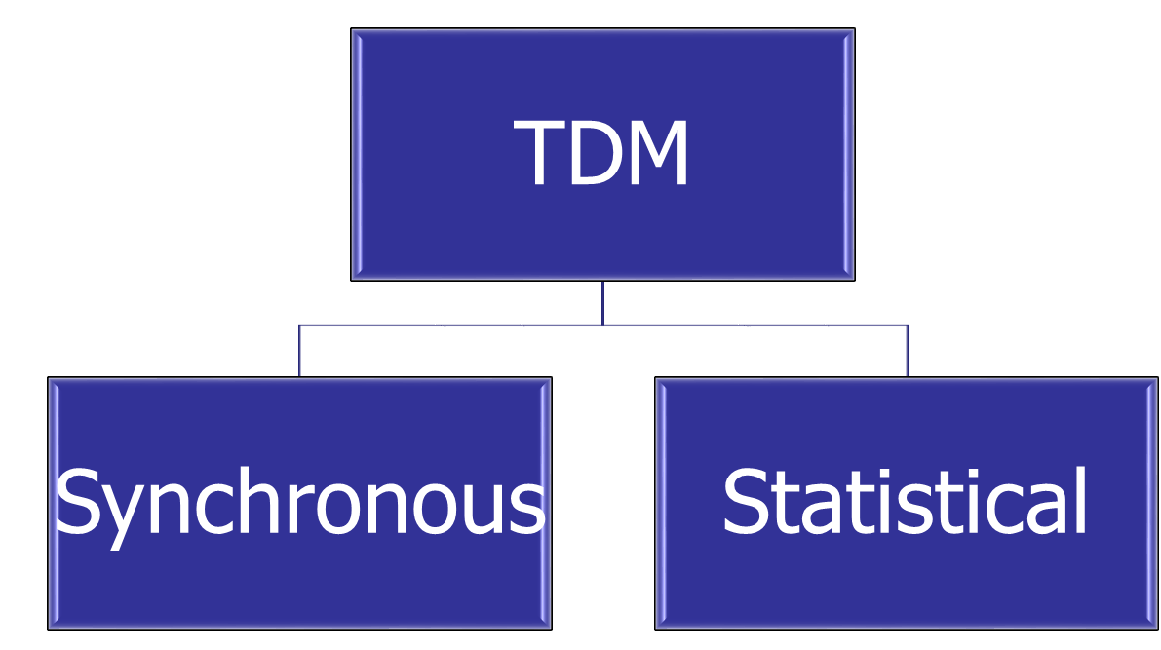
Time-Division Multiplexing(TDM)

Slide 27
Synchronous TDM :Terms
Each input connection has an allotment in the output even if it is not sending data.
The data flow in each input connection is divided into units, where each input occupies one input time slot.
System with n input lines, each frame has at least n slots
In TDM, the date rate of the link is n times faster and unit duration is n times shorter.
  Time slots
  Frames

Slide 28

Figure 6.13 Synchronous time-division multiplexing
6.<number>

Slide 29
Example 6.5
In Figure 6.13, the data rate for each input connection is 1 kbps. If 1 bit at a time is multiplexed (a unit is 1 bit), what is the duration of (a) each input slot, (b) each output slot, and (c) each frame?
Solution
a. The data rate of each input connection is 1 kbps. This means that the bit duration is 1/1000 s or 1 ms. The duration of the input time slot is 1 ms (same as bit duration).
6.<number>

Slide 30
Example 6.5 (continued)
b. The duration of each output time slot is one-third of the input time slot. This means that the duration of the output time slot is 1/3 ms.
c. Each frame carries three output time slots. So the duration of a frame is 3 × 1/3 ms, or 1 ms. The duration of a frame is the same as the duration of an input unit.
6.<number>

Slide 31

6.<number>

Slide 32
Example 6.6
Figure 6.14 shows synchronous TDM with a data stream for each input and one data stream for the output. The unit of data is 1 bit. Find (a) the input bit duration, (b) the output bit duration, (c) the output bit rate, and (d) the output frame rate.
Solution
We can answer the questions as follows:
a. The input bit duration is the inverse of the bit rate:
1/1 Mbps = 1 μs.
b. The output bit duration is one-fourth of the input bit duration, or ¼ μs.
6.<number>

Slide 33
Example 6.6 (continued)
c. The output bit rate is the inverse of the output bit duration or 1/(4μs) or 4 Mbps. This can also be deduced from the fact that the output rate is 4 times as fast as any input rate; so the output rate = 4 × 1 Mbps = 4 Mbps.
d. The frame rate is always the same as any input rate. So the frame rate is 1,000,000 frames per second. Because we are sending 4 bits in each frame, we can verify the result of the previous question by multiplying the frame rate by the number of bits per frame.
6.<number>

Slide 34
Figure 6.14 Example 6.6
6.<number>

Slide 35
Example 6.7
Four 1-kbps connections are multiplexed together. A unit is 1 bit. Find (a) the duration of 1 bit before multiplexing, (b) the transmission rate of the link, (c) the duration of a time slot, and (d) the duration of a frame.
Solution
We can answer the questions as follows:
a. The duration of 1 bit before multiplexing is 1 / 1 kbps, or 0.001 s (1 ms).
b. The rate of the link is 4 times the rate of a connection, or 4 kbps.
6.<number>

Slide 36
Example 6.7 (continued)
c. The duration of each time slot is one-fourth of the duration of each bit before multiplexing, or 1/4 ms or 250 μs. Note that we can also calculate this from the data rate of the link, 4 kbps. The bit duration is the inverse of the data rate, or 1/4 kbps or 250 μs.
d. The duration of a frame is always the same as the duration of a unit before multiplexing, or 1 ms. We can also calculate this in another way. Each frame in this case has four time slots. So the duration of a frame is 4 times 250 μs, or 1 ms.
6.<number>

Slide 37

Figure 6.15 Interleaving
6.<number>

Slide 38
Example 6.8
Four channels are multiplexed using TDM. If each channel sends 100 bytes /s and we multiplex 1 byte per channel, show the frame traveling on the link, the size of the frame, the duration of a frame, the frame rate, and the bit rate for the link.
Solution
The multiplexer is shown in Figure 6.16. Each frame carries 1 byte from each channel; the size of each frame, therefore, is 4 bytes, or 32 bits. Because each channel is sending 100 bytes/s and a frame carries 1 byte from each channel, the frame rate must be 100 frames per second. The bit rate is 100 × 32, or 3200 bps.
6.<number>

Slide 39

Figure 6.16 Example 6.8
6.<number>

Slide 40
Example 6.9
A multiplexer combines four 100-kbps channels using a time slot of 2 bits. Show the output with four arbitrary inputs. What is the frame rate? What is the frame duration? What is the bit rate? What is the bit duration?
Solution
Figure 6.17 shows the output for four arbitrary inputs. The link carries 50,000 frames per second. The frame duration is therefore 1/50,000 s or 20 μs. The frame rate is 50,000 frames per second, and each frame carries 8 bits; the bit rate is 50,000 × 8 = 400,000 bits or 400 kbps. The bit duration is 1/400,000 s, or 2.5 μs.
6.<number>

Slide 41

Figure 6.17 Example 6.9
6.<number>

Slide 42

Figure 6.18 Empty slots
6.<number>

Slide 43
Data Rate Management
Assumption so far all input data rates are same
Disparity in input data rates?
Three strategies
  Multilevel Multiplexing
  Multiple-slot Allocation
  Pulse Stuffing
6.<number>

Slide 44

Figure 6.19 Multilevel multiplexing
6.<number>

Slide 45

Figure 6.20 Multiple-slot multiplexing
6.<number>

Slide 46

Figure 6.21 Pulse stuffing
6.<number>

Slide 47
Frame synchronization
Synchronization between the multiplexer and demultiplexer is a major issue in TDM.
Bit belonging to one chanel may be received by another.
Solution: Framing Bits
  Follows a pattern, frame to frame
6.<number>

Slide 48

Figure 6.22 Framing bits
6.<number>

Slide 49
Example 6.10
We have four sources, each creating 250 characters per second. If the interleaved unit is a character and 1 synchronizing bit is added to each frame, find (a) the data rate of each source, (b) the duration of each character in each source, (c) the frame rate, (d) the duration of each frame, (e) the number of bits in each frame, and (f) the data rate of the link.
Solution
We can answer the questions as follows:
a. The data rate of each source is 250 × 8 = 2000 bps = 2 kbps.
6.<number>

Slide 50
Example 6.10 (continued)
b. Each source sends 250 characters per second; therefore, the duration of a character is 1/250 s, or
4 ms.
c. Each frame has one character from each source, which means the link needs to send 250 frames per second to keep the transmission rate of each source.
d. The duration of each frame is 1/250 s, or 4 ms. Note that the duration of each frame is the same as the duration of each character coming from each source.
e. Each frame carries 4 characters and 1 extra synchronizing bit. This means that each frame is
4 × 8 + 1 = 33 bits.
6.<number>

Slide 51
Example 6.11
Two channels, one with a bit rate of 100 kbps and another with a bit rate of 200 kbps, are to be multiplexed. How this can be achieved? What is the frame rate? What is the frame duration? What is the bit rate of the link?
Solution
We can allocate one slot to the first channel and two slots to the second channel. Each frame carries 3 bits. The frame rate is 100,000 frames per second because it carries 1 bit from the first channel. The bit rate is 100,000 frames/s × 3 bits per frame, or 300 kbps.
6.<number>

Slide 52

Digital Signal Service
Telephone companies implement TDM through a hierarchy of digital signals, called digital signal (DS) service or digital hierarchy.
Figure 6.23 Digital hierarchy
6.<number>

Slide 53

T LINES
DS-0, DS-1, and so on are the names of services.
To implement those services, the telephone companies use T lines (T-1 to T-4). These are lines with capacities precisely matched to the data rates of the DS-1 to DS-4 services (see Table 6.1).
So far only T-1and T-3 lines are commercially available.
Table 6.1 DS and T line rates
6.<number>

Slide 54

Figure 6.24 T-1 line for multiplexing telephone lines
6.<number>

Slide 55

Figure 6.25 T-1 frame structure
6.<number>

Slide 56

E LINES
Europeans use a version of T lines called E lines.
The two systems are conceptually identical, but their capacities differ..
Table 6.2 E line rates
6.<number>

Slide 57
Statistical Time Division Multiplexing
Slots are dynamically allocated to improve bandwidth efficiency.
Only when an input line has a slot’s worth of data to send is it given a slot in the output frame.
The number of slots in each frame is less than the number of input lines.
6.<number>

Slide 58
Statistical TDM - Differences
Addressing
  A slot needs to carry data as well as the address of the destination.
Slot Size
  Since a slot carries both data and an address in statistical TDM, the ratio of the data size to address size must be reasonable to make transmission efficient.
  In statistical TDM, a block of data is usually many bytes while the address is just a few bytes.
6.<number>

Slide 59

Figure 6.26 TDM slot comparison
6.<number>

Slide 60
Statistical TDM - Differences
No synchronization bit
Bandwidth
  The capacity of the link is normally less than the sum of the capacities of each channel.
6.<number>

